Slide 1
Working from the Home Environment & Well-Being Study Data
Project Motivation:To know the health effects of working from home because it is valuable for both the company and the individual.
Project Goal: Analyze the effects, both physically and mentally, of remote work over a long period of time (6 months).
Project Background: Certain teams have already gone fully remote while many have gone fully hybrid. We will be working with surveys and Garmin Watch data.
Hypothesis: People who take four or more breaks suffer less pain than those who take two or less breaks.
Further Analysis: Predict Life-Satisfaction using various covariates.
Sponsor:College of Health and Rehabilitation Sciences: Sargent College
Team Members: Rahul Razdan, Jiang Du, Ying Han Dai, Anish Warty

Slide 2
Compared the average pain in a naive approach and found a difference between that of people who take break less than 2 times and those who take break more than 4 times a day.
Plot 2 month, 3 month, 4 month datasets and produced plot to compare the distribution before and after removing outliers
Check the assumptions and conducted pair t-tests to see if there is a pain difference between the two group after removing the outliers. Could not reject the null hypothesis.
Repeat process for two month, four month, and eventually six month data
Use Demographic, Daily Breaks, and Location data to predict Life Satisfaction on 3 month data.
Redone the pair t-tests to see whether we can reject the null hypothesis using datasets with outliers. We reject the null hypothesis for 4 month dataset
Diving up the work in half and assigning them to two small group comprises of two people, we applied a interactive work mode by furthering another groups work and switching between each other’s work to gain a comprehensive understanding of the whole project.
By utilizing data ranging from second month to fourth month, we develop a sense of how does people’s pain changes as they take breaks in a long time scale.

Slide 3
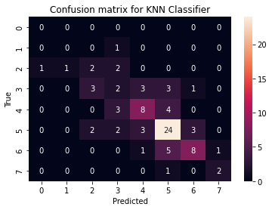
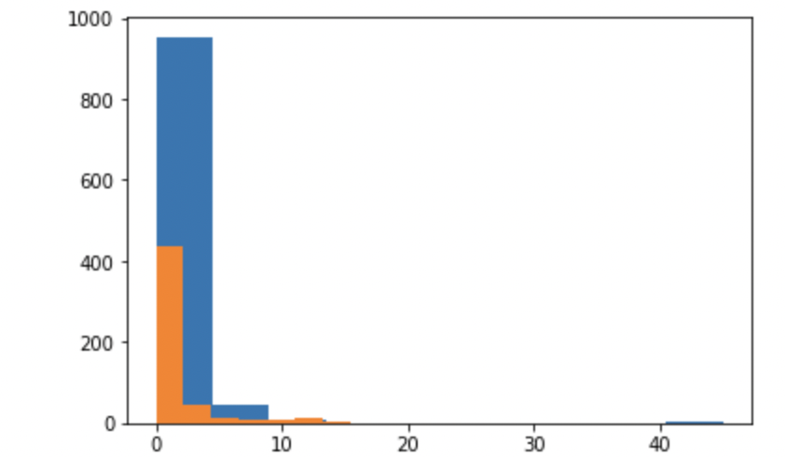
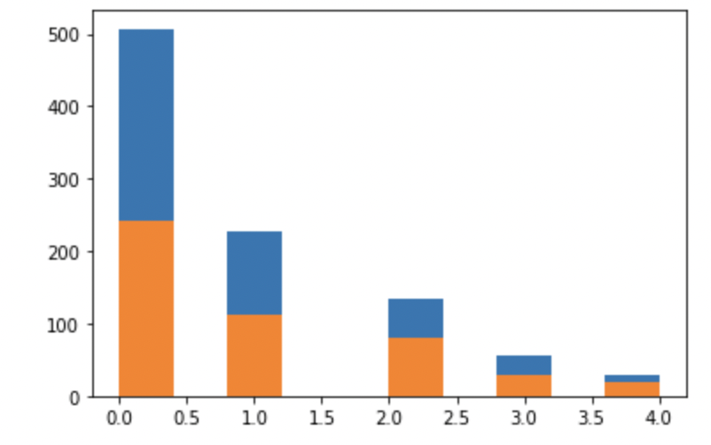
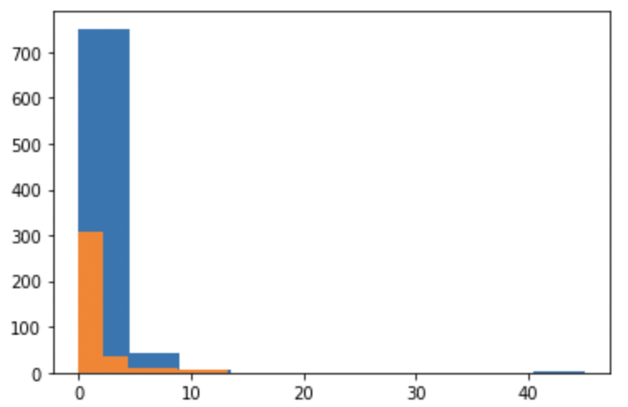
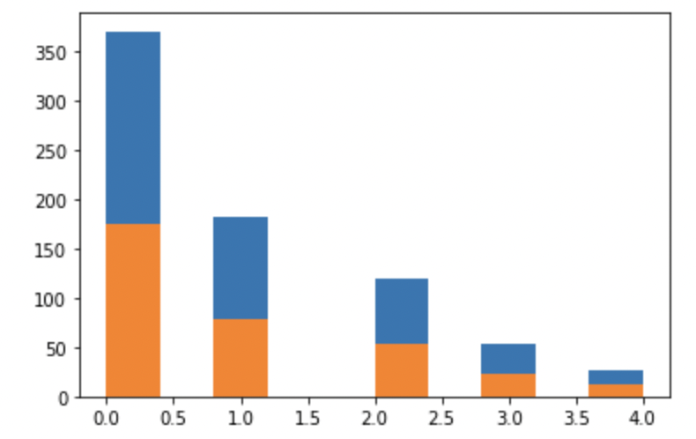
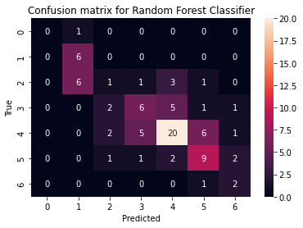
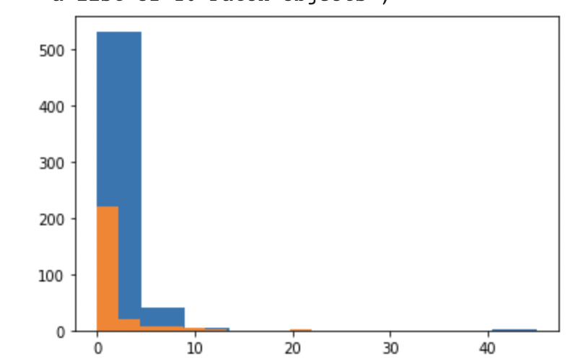
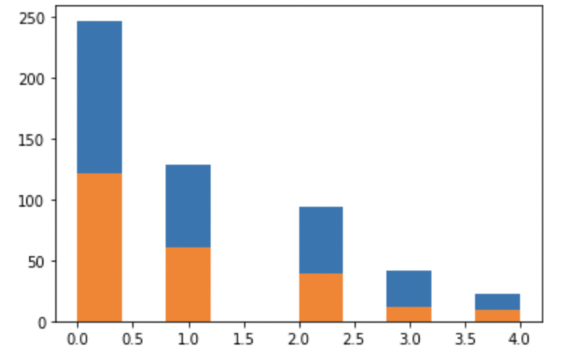
No statistical-significant difference between the two groups in any month after removing the outliers.
4 month data with outliers: 4 month data without outliers:
3 month data with outliers 3 month data without outliers
2 month data with outliers 2 month data without outliers

Slide 4
Challenges
Challenges
With removed outliers, there were no significant differences
Pain may cause individuals to take more breaks. Thus, it is difficult to conduct analysis as there may be causation.
Difficult to prevent overfitting due to the small number of data.
Life Satisfaction is an objective variable and hence can be different for different individuals.
Next Steps
Next Steps
Examine the cause-effect relationship between number of breaks and pain.
Re-analyze the inclusion and exclusion of outliers.
Repeat steps for two month, four month and six month data.
Use Garmin data to get better indicators of stress and heart rate to use as covariates.
Notes:
Any additional challenges you have encountered?
What limitations have you encountered? What assumptions have you had to make?
Based on the (early) results, what are the expected next steps?
What are you planning to do to complete your project?
Challenges for conducting hypothesis:
We found out that with removed outliers they all showed no significant difference.
People might originally have more pains and they are required to take breaks for more time. Therefore, people who take break more than four times may bear more pains compared to another group. Therefore, It is difficult to deal with outliers, because we lack the information on driven factors for patients to take a break.
Next Steps: we need to examine the cause-effect relationship between the number of breaks and numbers of pains that have been report. Then, we need to re-analysis the inclusion and exclusion of possible outliers.

